Slide 1

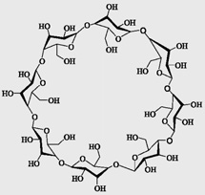
Cyclodextrins
Χημεία Μακροκυκλικών Ενώσεων
Καθηγητής: Αθανάσιος Κουτσολέλος
Σπινθάκη Αργυρώ Α.Μ : 838
Πανεπιστήμιο Κρήτης - Τμήμα Χημείας
Απρίλιος 2015

Slide 2
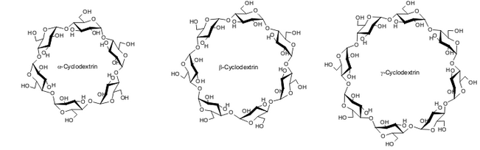
Starting…
Some carbohydrates (cellulose, starch and sucrose) are abundant in nature
Cyclodextrins are a family of cyclic oligosaccharides, made up of sugar molecules bound together in a ring (α -(1,4) linked glucopyranose subunits)
They are produced as a result of intramolecular transglycosylation reaction from degradation of starch by cyclodextrin glucanotransferase (CGTase) enzyme
Typical cyclodextrins contain a number of glucose monomers ranging from six to eight units in a ring, thus denoting: α- (6 units), β- (7 units), γ- (8 units)
Τhe majority of their reactions are of ‘host–guest’ type

Slide 3
History
1891: A. Villiers → discovery of “cellulosine’’
1903- 1911: Schrardinger → isolation of A and B crystalline products, plus isolation of the bacteria responsible for cd synthesis - crystallized dextrins α and β 25-30% from starch
1935: isolation of dextin γ
…..the structure of the compounds are still uncertain…..
1942: the structures of α and β were determined by X-ray crystallography!!
1948: X-ray crystallography for γ-cd plus cds can form inclusion complexes
1961: evidence for the natural existence of δ-, ζ-, ξ- and η- cds (9-12 units)
1981: 1st International cd symposium – 1st cd book is published
Up to now:
the largest well-characterized cd: 32 sugar units
poorly characterized mixtures even at least 150-membered cds.
Intensive research on cd aggregation is still going on….

Slide 4
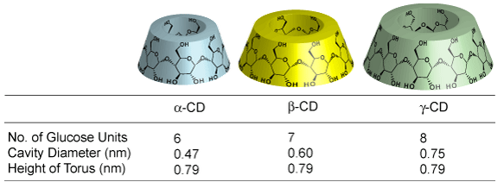
Structure
cage-like supramolecular structure, like cryptands, calixarenes and crown ethers
From X-ray we get that the secondary hydroxyl groups (C₂ and C₃) are located on the wider edge of the ring and the primary hydroxyl groups (C₆) on the other edge, and that the apolar C₃ and C₅ hydrogens and ether-like oxygens are at the inside of the torus-like molecules.
“micro heterogeneous environment”
Formation of inclusion complexes with a variety of hydrophobic guest molecules

Slide 5
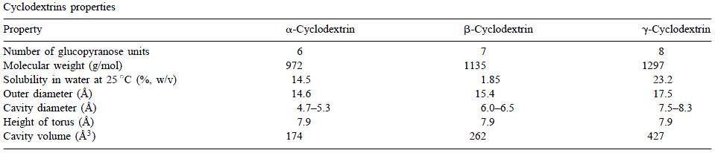
Properties
Solubility: poorly to moderately soluble in water, methanol and ethanol
readily soluble in strongly polar aprotic solvents like dimethyl sulfoxide (DMSO), dimethylformamide (DMF), N,N-dimethylacetamide and pyridine
the torus is stabilized by intramolecular hydrogen bonds but it is still flexible enough to permit considerable deviations from regular toroidal shape
Complete rotation of a glucose unit about the C(1)-O-C(4') bonds is not possible for steric reasons

Slide 6
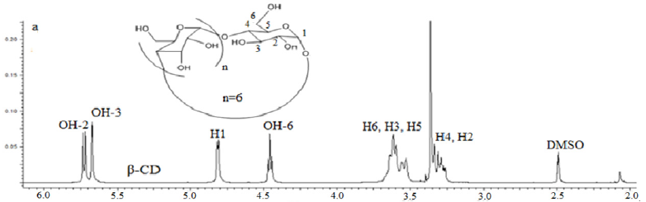
NMR Spectra
C_{n} symmetry→ all the glucose building blocks are equivalent by 'H and ¹³C NMR spectroscopy

Slide 7
Synthesis
Treatment of ordinary starch with a set of easily available enzymes.
Steps:
CGTase is employed along with α-amylase.
starch is liquified either by heat treatment or using α-amylase
CGTase is added for the enzymatic conversion
CGTases can synthesize all forms of cyclodextrins,
mixture of the three main types of cyclic molecules
each CGTase has its own characteristic α:β:γ synthesis ratio.
Purification:
different water solubility of the molecules
"complexing agent"

Slide 8
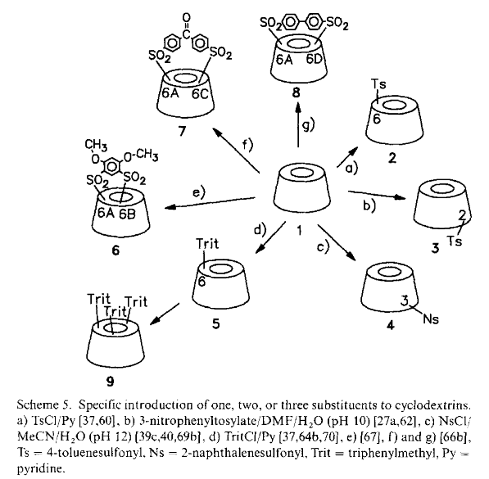
Derivatives
Usually aminations, esterifications or etherifications of primary and secondary hydroxyl groups of the cyclodextrins
electrophilic attack at the OH-groups: formation of ethers and esters by alkyl halides, epoxides, acyl derivatives, isocyanates
nucleophilic attack by compounds such as azide ions, halide ions, thiols, thiourea, and amines; this requires activation of the oxygen atom by an electron-withdrawing group

Slide 9
Derivatives
Cds can link covalently or non-covalently to other cds→ building blocks!!
Construction of supramolecular complexes
Why bother?...
All derivative properties differ from that of their parent cyclodextrins
Depending on the substituent:
the solubility of the cyclodextrin derivatives is usually different
Virtually all derivatives have a changed hydrophobic cavity volume
Improve: solubility, stability against light or oxygen
help control the chemical activity of guest molecules

Slide 10
Applications
β-cd is the most accessible, the lowest-priced and generally the most useful
use to solubilize non-polar compounds such a fatty acids, lipids and cholesterol.
Food industry: cholesterol free products
pharmaceutical applications for drug release
selective precipitation of enantiomeric, positional or structural isomers
useful molecular chelating agents
environmental protection:
-adsorption of toxic compounds (trichloroethane, heavy metals)
- can form complexes with stable substances enhancing their decomposition
solid cd micro particles are exposed to a controlled contact with fumes of active compounds, then they are added to fabric or paper products→ release of fragrance during ironing etc.

Slide 11
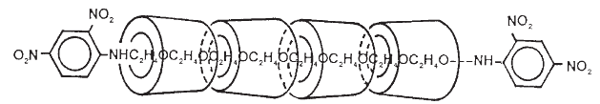
The molecular necklace
A molecular necklace prepared from complexes of poly(ethylene glycol) bisamine with α- cds by capping the complexes with 2,4- dinitrofluorobenzene (20-30 α- cds per PEG molecule)
“Such molecular organization is important, not only in biological systems and chemical processes, but also in the creation of molecular devices.”
Nature, 1992

Slide 12
References
A. Harada, J. Li and M. Kamachi, The Molecular Neclace: a rotaxane containing many threaded α-cyclodextrins, Nature,Vol 356, (1992)
Gerhard Wenz, Cyclodextrins as Building Blocks for Supramolecular Structures and Functional Units, Angew,. Chem. Int. Ed. Engl. 1994, 33, 803-822
Sergey V. Kurkov, Thorsteinn Loftsson, Cyclodextrins Review, International Journal of Pharmaceutics 453 (2013) 167– 180
E.M. Martin Del Valle, Cyclodextrins and their uses: a review, Process Biochemistry 39 (2004) 1033–1046
Thorsteinn Loftsson, Dominique Duchene, Cyclodextrins and their pharmaceutical applications, International Journal of Pharmaceutics 329 (2007) 1–11
Phatsawee Jansook, Thorsteinn Loftsson, CDs as solubilizers: Effects of excipients and competing drugs, International Journal of Pharmaceutics 379 (2009) 32–40
Villiers A., Sur la transformation de la fécule en dextrine par le ferment butyrique, Compt. Rend. Fr. Acad. Sci. 1891:435-8
Biwer A, Antranikian G, Heinzle E. Enzymatic production of cyclodextrins. Appl Microbiol Biotechnol 2002;59:609-17.
M. Raoov ,S. Mohamad and M.Abas, Synthesis and Characterization of β-Cyclodextrin Functionalized Ionic Liquid Polymer as a Macroporous Material for the Removal of Phenols and As(V), Int. J. Mol. Sci. 2014, 15

Slide 13


